Slide 2

Image Analysis ll
Radovan Fusek

Slide 3
Object Detection (Analysis)
Haar, Integral Image, AdaBoost

Slide 4
What is Object Detection?
It is clear that the images contain many objects of interest. The goal of the object detection
systems is to find the location of these objects in the images (e.g. cars, faces, pedestrians).
For example, the vehicle detection systems are crucial for traffic analysis or intelligent scheduling, the people detection systems can be useful for automotive safety, and the face detection systems are a key part of face recognition systems.
Radovan Fusek: Descriptors for Object Detection in Image Recognition, Philosophiæ Doctor Thesis, 2016

Slide 5
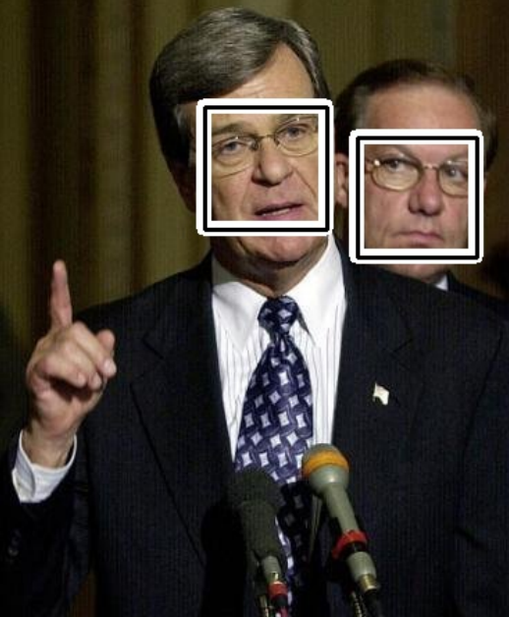
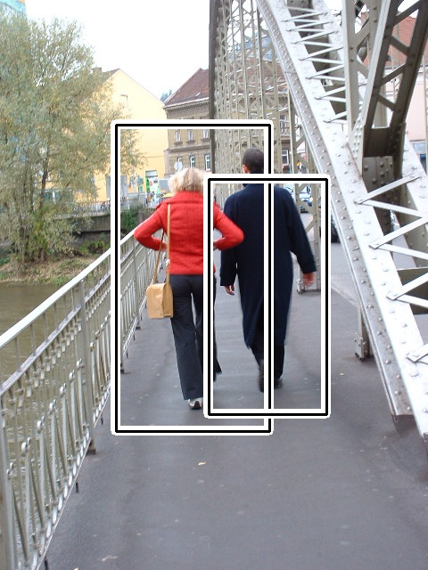
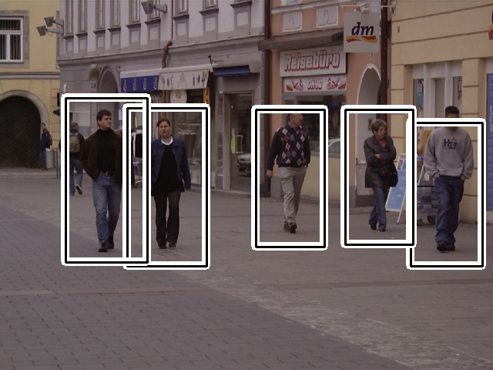
What is Object Detection?
Output?
  position of the objects
  scale of the objects

Slide 6
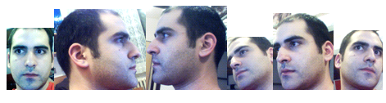
Problems (Challenges)
different views - different objects

Slide 7
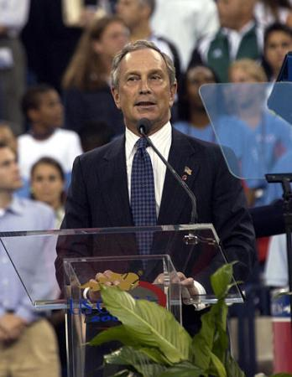
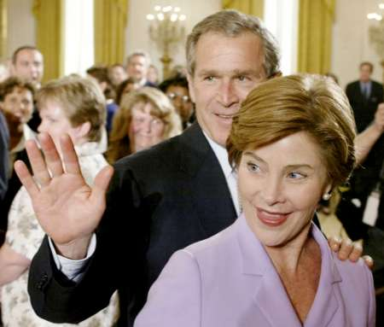
Problems (Challenges)
low quality images
http://vis-www.cs.umass.edu/fddb/

Slide 8
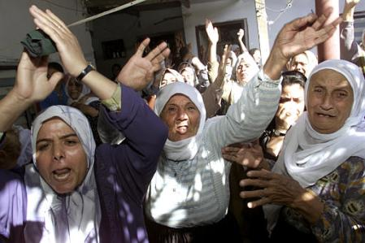
Problems (Challenges)
illumination + low quality
http://vis-www.cs.umass.edu/fddb/

Slide 9
Image Features
The objects of interest can be described using various image information (e.g. shape, texture, colour). In the area of feature based detectors the image features are the carries of this information.
Many methods for extracting the image features that are able to describe the appearance of objects were presented, especially, the detectors that are based on the histograms of oriented gradients (HOG), Haar features, or local binary patterns (LBP) are dominant and they are considered as the state-of-the-art methods.

Slide 10
Object Detection/Recognition
Haar
HOG
LBP
SIFT, SURF KeyPoints
CNNs
Practical examples using OpenCV + Dlib (https://opencv.org/, http://dlib.net/)
Traditional Approaches
Deep Learning Approach

Slide 11
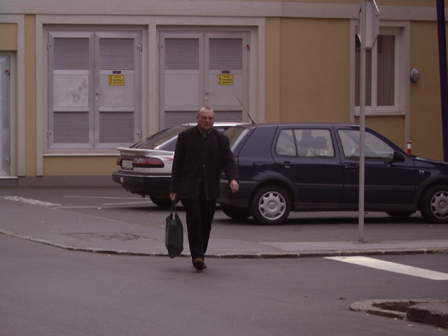
Sliding Window - Main Idea
Constantine Papageorgiou and Tomaso Poggio: A Trainable System for Object Detection.
Int. J. Comput. Vision 38, pp. 15-33. (2000)

Slide 12



Sliding Window - Main Idea
Constantine Papageorgiou and Tomaso Poggio: A Trainable System for Object Detection.
Int. J. Comput. Vision 38, pp. 15-33. (2000)

Slide 13
Sliding Window - Main Idea
In general, the sliding window technique represents the popular and successful approach for object detection. The main idea of this approach is that the input image is scanned by a rectangular window at multiple scales. The result of the scanning process is a large number of various sub-windows. A vector of features is extracted from each sub-window. The vector is then used as an input for the classifier (e.g. SVM classifer).
During the classification process, some sub-windows are marked as the objects. Using the sliding window approach, the multiple positive detections may appear, especially around the objects of interest

Slide 14
Sliding Window - Main Idea
These detections are merged to the final bounding box that represents the resulting detection.
The classifer that determines each sub-window is trained over the training set that consists of positive and negative images.
The key point is to find what values (features) should be used to effectively encode the image inside the sliding window.

Slide 15
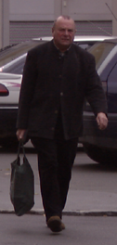
Detection Process
Feature Vector
(gradient, HOG, LBP, …)
Constantine Papageorgiou and Tomaso Poggio: A Trainable System for Object Detection.
Int. J. Comput. Vision 38, pp. 15-33. (2000)

Slide 16
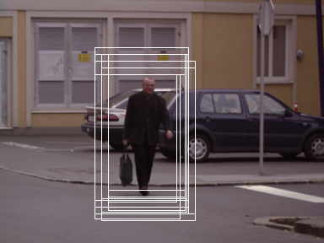
Detection Process
Feature Vector
(gradient, HOG, LBP, …)
Trainable Classifier
(SVM, ANNs, …)
Constantine Papageorgiou and Tomaso Poggio: A Trainable System for Object Detection.
Int. J. Comput. Vision 38, pp. 15-33. (2000)

Slide 17
Detection Process
Typically, in the area of feature-based detectors, the detection algorithms consist of two main parts. The extraction of image features is the first part. The second part is created by the trainable
classifirs that handle a final classification (object/non-object).
The extraction of relevant features has a significant inﬂuence on the successfulness of detectors. The large number of features slows down the training and detection phases; on the other hand a very small number of features may not be able to describe the properties of object of interest.
The quality of training set is also equally important.

Slide 18
Generating Training Set
negative set - without the object of interest
positive set
    rotation
    noise
    Illumination
    scale

Slide 19
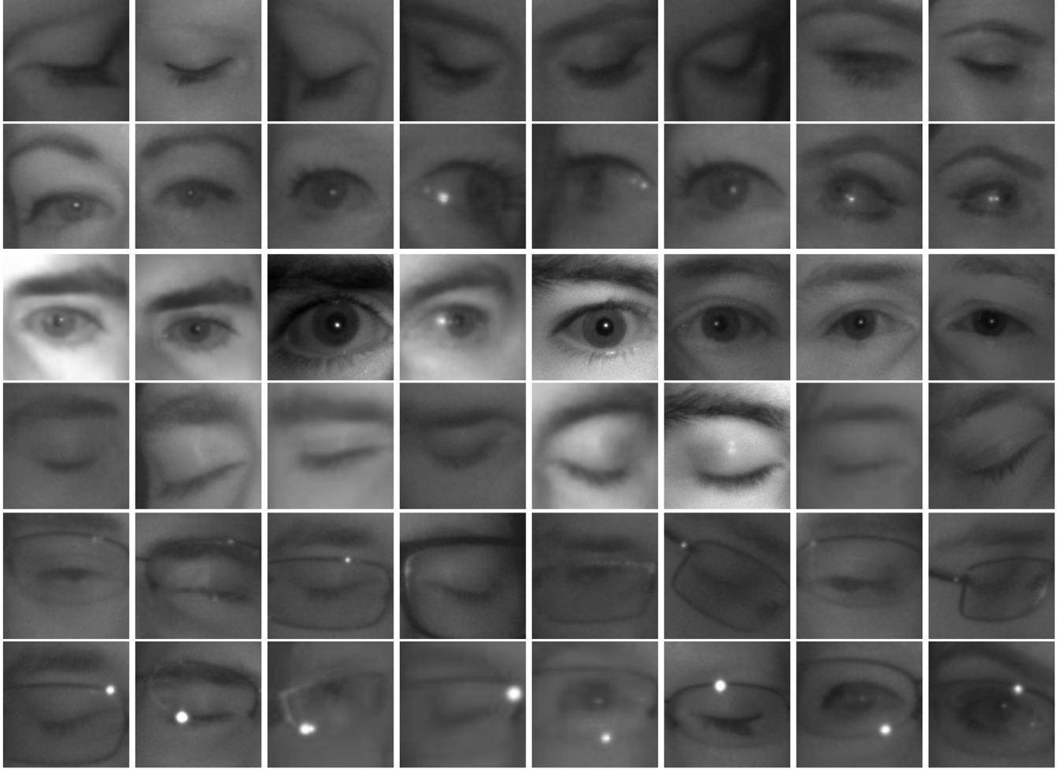
http://mrl.cs.vsb.cz/eyedataset

Slide 20
Haar
HOG
LBP
SIFT, SURF KeyPoints
CNNs
Traditional Approaches
Deep Learning Approach

Slide 21

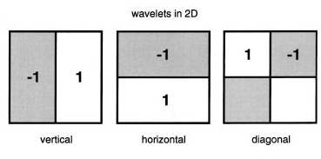

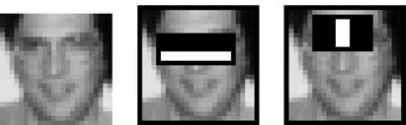
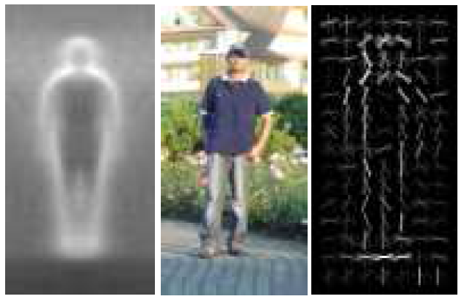
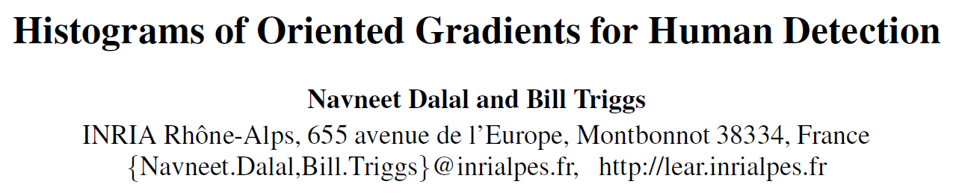
Related Works
2000
Papageorgiou
(2000)
Viola, Jones
(2001,2004)
cit. > 6500
Dalal, Triggs
(2005)
cit. > 10000
2005

Slide 22
Haar Wavelet-based Descriptors
  The main idea behind the Haar-like features is that the features can encode the differences of mean intensities between the rectangular areas. For instance, in the problem of face detection, the regions around the eyes are lighter than the areas of the eyes; the regions bellow or on top of eyes have different intensities that the eyes themselves.
  These specific characteristics can be simply encoded by one two-rectangular feature, and the value of this feature can be calculated as the difference between the sum of the intensities inside the rectangles.

Slide 23
Haar Wavelet-based Descriptors
  The paper of Viola and Jones contributed to the popularity of Haar-like features. The authors proposed the object detection framework based on the image representation called the integral image combined with the rectangular features, and the AdaBoost algorithm.
  With the use of integral image, the rectangular features are computed
  very quickly. The AdaBoost algorithm helps to select the most important features.
  The features are used to train classifers and the cascade of classifers is used for reducing
  the computational time.

Slide 24
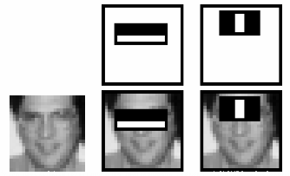
Haar Wavelet-based Descriptors
faces have similar properties
  eye regions are darker than the upper-cheeks
  the nose bridge region is brighter than the eyes
https://docs.opencv.org/3.4.1/d7/d8b/tutorial_py_face_detection.html

Slide 25
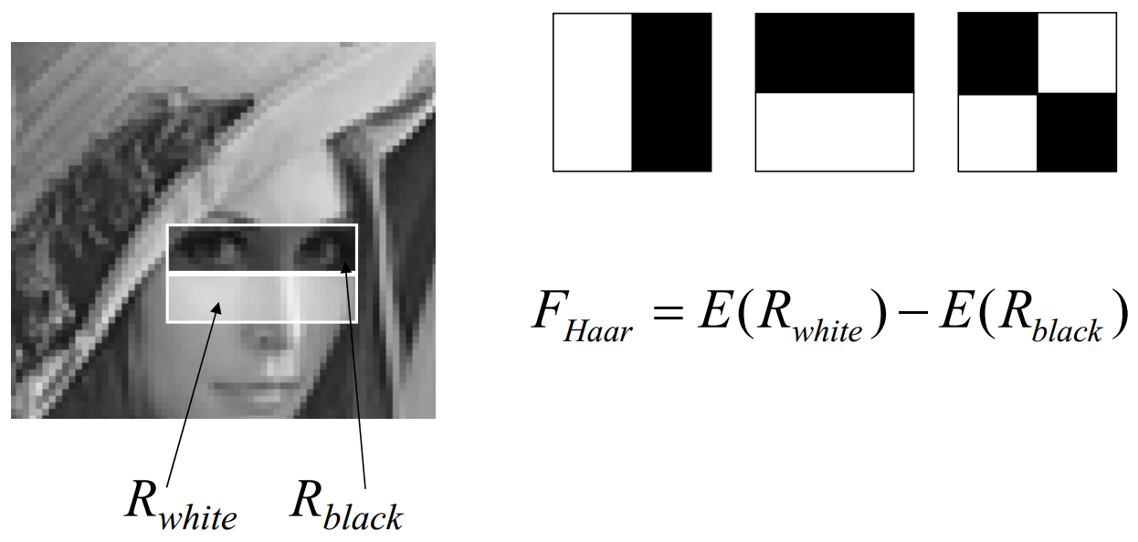
Features
Rectangular features
David Gerónimo: Haar-like Features and Integral Image Representation, Master in Computer Vision and Artificial Intelligence, 18th December 2009

Slide 26
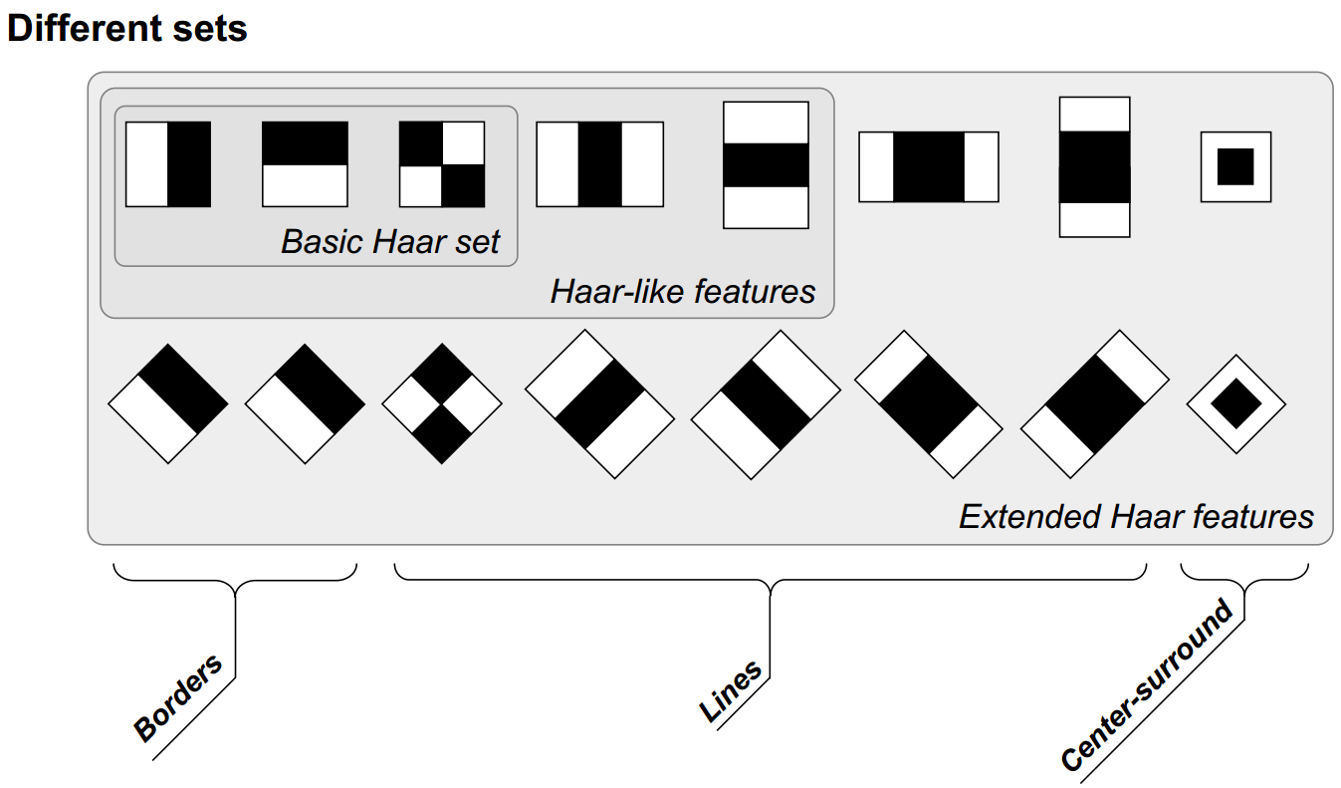
Features
David Gerónimo: Haar-like Features and Integral Image Representation, Master in Computer Vision and Artificial Intelligence, 18th December 2009

Slide 27
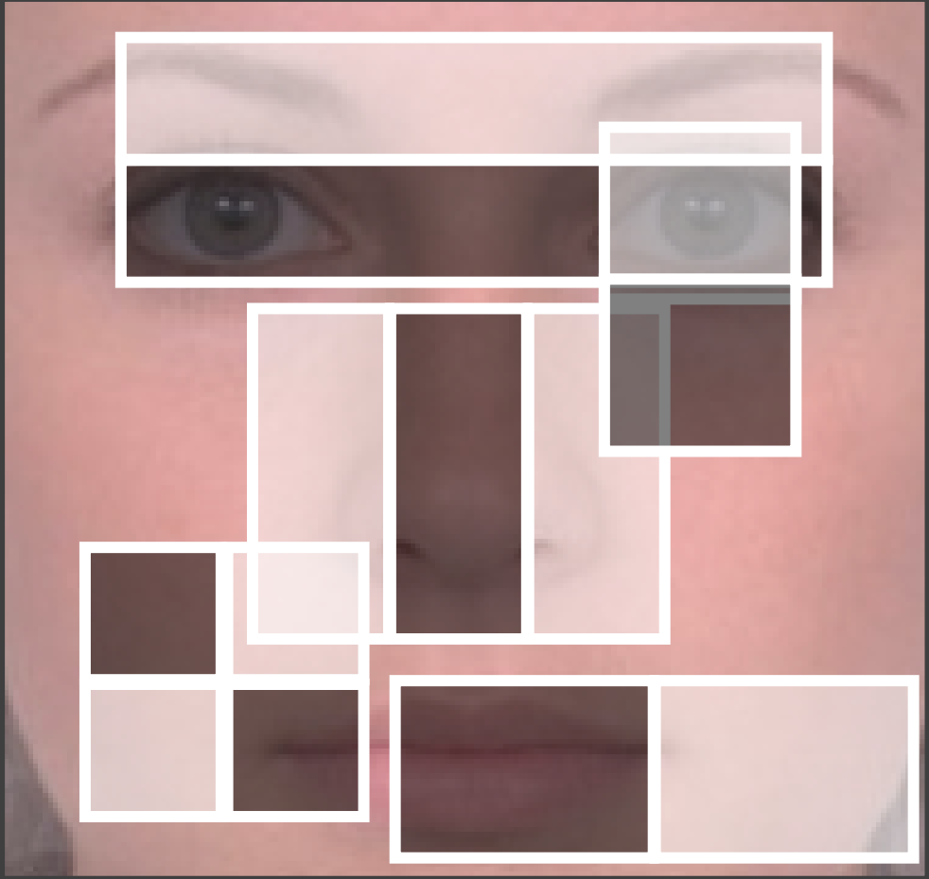
Face Detection
24x24 sub-window aprox. 160,000 rectangular features
How speed the computational speed?
  decrease memory accesses
David Gerónimo: Haar-like Features and Integral Image Representation, Master in Computer Vision and Artificial Intelligence, 18th December 2009

Slide 28
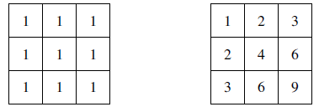
Integral Image
  Original image (i)
  Integral image (ii)

Slide 29
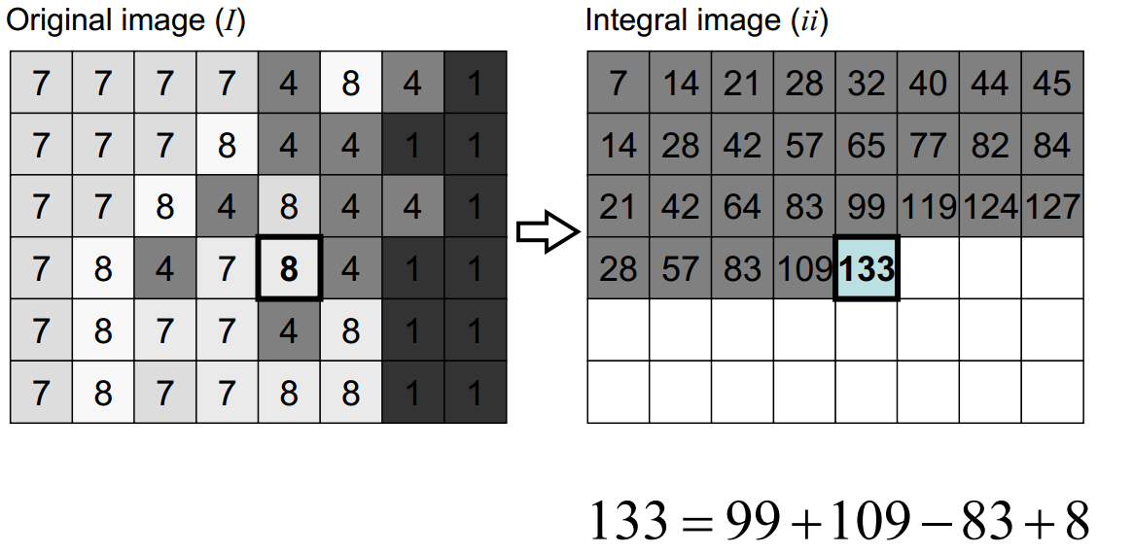
Integral Image
David Gerónimo: Haar-like Features and Integral Image Representation, Master in Computer Vision and Artificial Intelligence, 18th December 2009

Slide 30
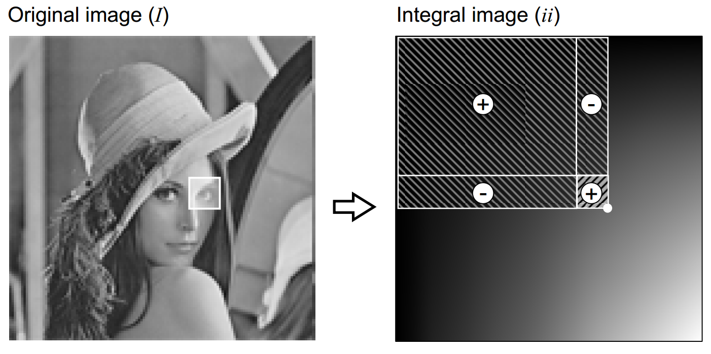
Integral Image
David Gerónimo: Haar-like Features and Integral Image Representation, Master in Computer Vision and Artificial Intelligence, 18th December 2009

Slide 31
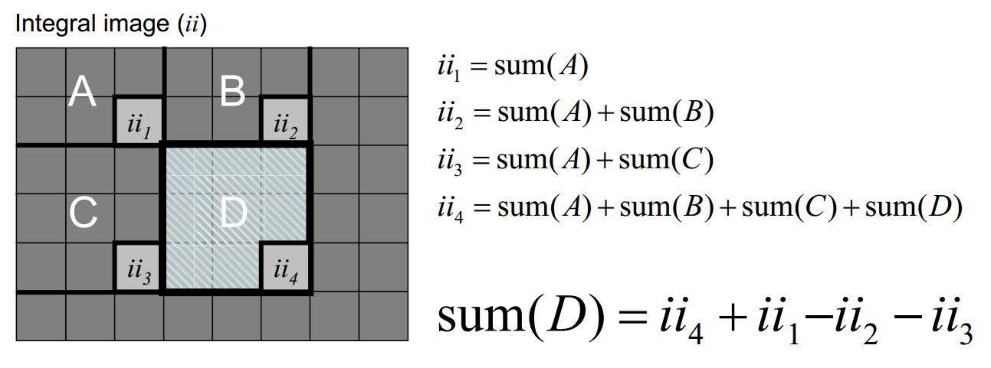
Integral Image
David Gerónimo: Haar-like Features and Integral Image Representation, Master in Computer Vision and Artificial Intelligence, 18th December 2009

Slide 32
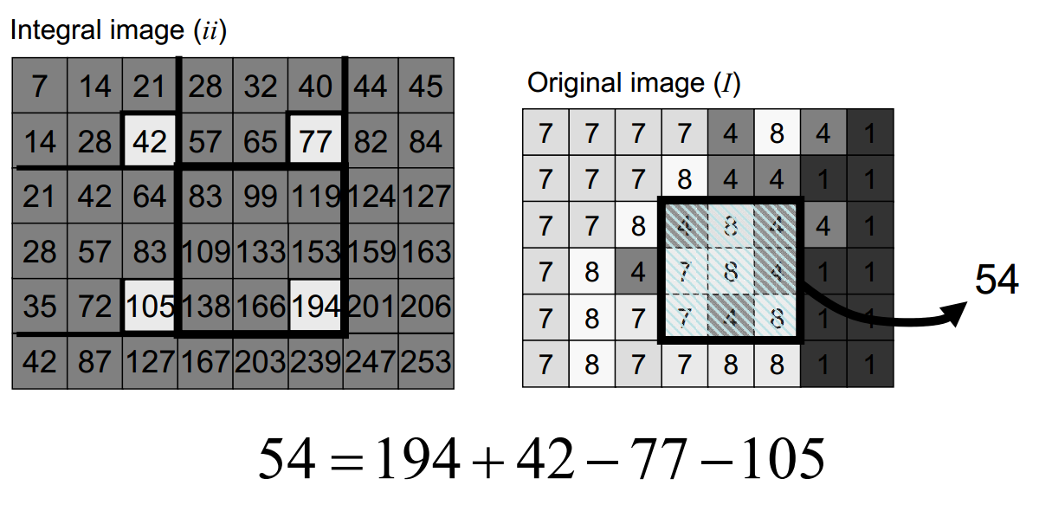
Integral Image
David Gerónimo: Haar-like Features and Integral Image Representation, Master in Computer Vision and Artificial Intelligence, 18th December 2009

Slide 33

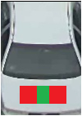
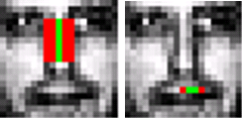
Feature Selection

Slide 34
Feature Selection
AdaBoost (Adaptive Boost) is an iterative learning algorithm to construct a “strong” classifier as a linear combination of weighted simple “weak” classifiers
  weak classifier - each single rectangle feature (features as weak classifiers)
  during each iteration, each example/image receives a weight determining its importance

Slide 35
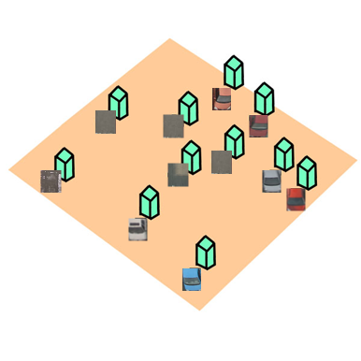
Feature Selection
AdaBoost starts with a uniform distribution of “weights” over training examples.
Slide taken from a presentation by Qing Chen, Discover Lab, University of Ottawa

Slide 36
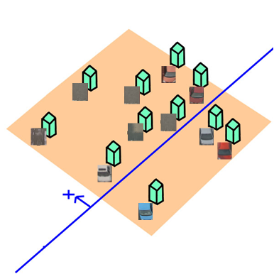
Feature Selection
AdaBoost starts with a uniform distribution of “weights” over training examples.
Select the classifier with the lowest weighted error (i.e. a “weak” classifier)
Slide taken from a presentation by Qing Chen, Discover Lab, University of Ottawa

Slide 37
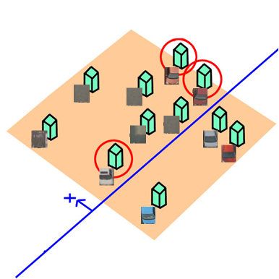
Feature Selection
AdaBoost starts with a uniform distribution of “weights” over training examples.
Select the classifier with the lowest weighted error (i.e. a “weak” classifier)
Increase the weights on the training examples that were misclassified.
Slide taken from a presentation by Qing Chen, Discover Lab, University of Ottawa

Slide 38
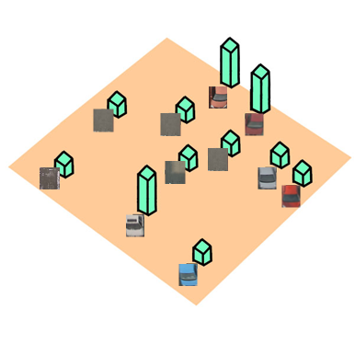
Feature Selection
AdaBoost starts with a uniform distribution of “weights” over training examples.
Select the classifier with the lowest weighted error (i.e. a “weak” classifier)
Increase the weights on the training examples that were misclassified.
Slide taken from a presentation by Qing Chen, Discover Lab, University of Ottawa

Slide 39
Feature Selection
AdaBoost starts with a uniform distribution of “weights” over training examples.
Select the classifier with the lowest weighted error (i.e. a “weak” classifier)
Increase the weights on the training examples that were misclassified.
(Repeat)
Slide taken from a presentation by Qing Chen, Discover Lab, University of Ottawa

Slide 40
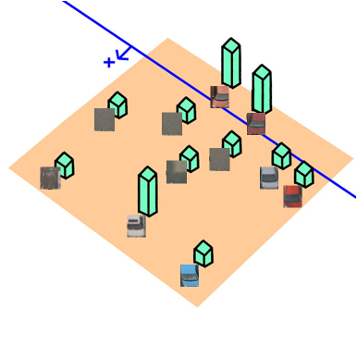
Feature Selection
AdaBoost starts with a uniform distribution of “weights” over training examples.
Select the classifier with the lowest weighted error (i.e. a “weak” classifier)
Increase the weights on the training examples that were misclassified.
(Repeat)
Slide taken from a presentation by Qing Chen, Discover Lab, University of Ottawa

Slide 41
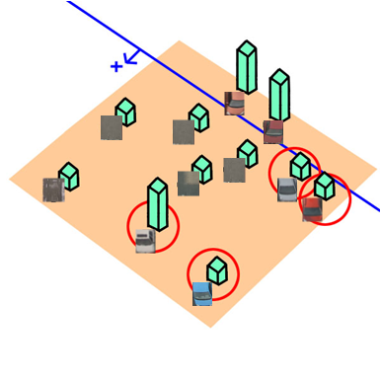
Feature Selection
AdaBoost starts with a uniform distribution of “weights” over training examples.
Select the classifier with the lowest weighted error (i.e. a “weak” classifier)
Increase the weights on the training examples that were misclassified.
(Repeat)
Slide taken from a presentation by Qing Chen, Discover Lab, University of Ottawa

Slide 42
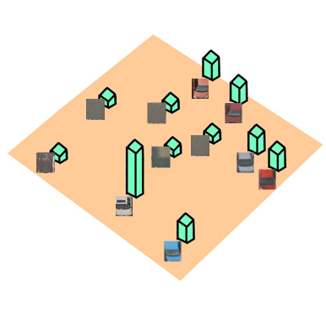
Feature Selection
AdaBoost starts with a uniform distribution of “weights” over training examples.
Select the classifier with the lowest weighted error (i.e. a “weak” classifier)
Increase the weights on the training examples that were misclassified.
(Repeat)
Slide taken from a presentation by Qing Chen, Discover Lab, University of Ottawa

Slide 43
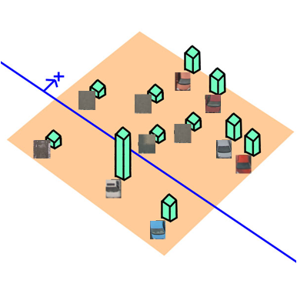
Feature Selection
AdaBoost starts with a uniform distribution of “weights” over training examples.
Select the classifier with the lowest weighted error (i.e. a “weak” classifier)
Increase the weights on the training examples that were misclassified.
(Repeat)
Slide taken from a presentation by Qing Chen, Discover Lab, University of Ottawa

Slide 44
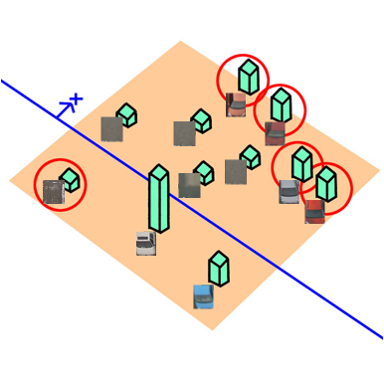
Feature Selection
AdaBoost starts with a uniform distribution of “weights” over training examples.
Select the classifier with the lowest weighted error (i.e. a “weak” classifier)
Increase the weights on the training examples that were misclassified.
(Repeat)
Slide taken from a presentation by Qing Chen, Discover Lab, University of Ottawa

Slide 45
Feature Selection
At the end, carefully make a linear combination of the weak classifiers obtained at all iterations.
Slide taken from a presentation by Qing Chen, Discover Lab, University of Ottawa

Slide 46
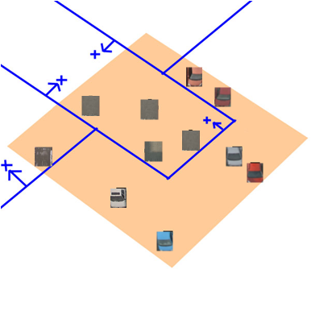
Feature Selection
At the end, carefully make a linear combination of the weak classifiers obtained at all iterations.
Slide taken from a presentation by Qing Chen, Discover Lab, University of Ottawa

Slide 47
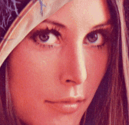
Cascade of Classifier
The idea of cascade classifier is reject the non-face region as soon as possible
Stage 1
Stage 2
Stage 3
Stage 4
Rejected Windows

Slide 48
The idea of cascade classifier is reject the non-face region as soon as possible
Cascade of Classifier
Stage 1
Stage 2
Stage 3
Stage 4
Rejected Windows

Slide 49
The idea of cascade classifier is reject the non-face region as soon as possible
Cascade of Classifier
Stage 1
Stage 2
Stage 3
Stage 4
Rejected Windows

Slide 50
The idea of cascade classifier is reject the non-face region as soon as possible
Cascade of Classifier
Stage 1
Stage 2
Stage 3
Stage 4
Rejected Windows

Slide 51
The idea of cascade classifier is reject the non-face region as soon as possible
Cascade of Classifier
Stage 1
Stage 2
Stage 3
Stage 4
Rejected Windows

Slide 52
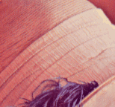
The idea of cascade classifier is reject the non-face region as soon as possible
Cascade of Classifier
Stage 1
Stage 2
Stage 3
Stage 4
Rejected Windows

Slide 53
The idea of cascade classifier is reject the non-face region as soon as possible
Cascade of Classifier
Stage 1
Stage 2
Stage 3
Stage 4
Rejected Windows

Slide 54
The idea of cascade classifier is reject the non-face region as soon as possible
Cascade of Classifier
Stage 1
Stage 2
Stage 3
Stage 4
Rejected Windows

Slide 55
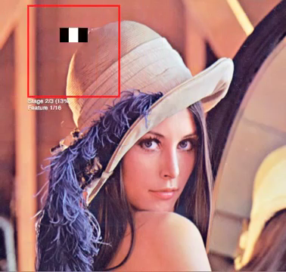
Haar Features
https://vimeo.com/12774628

Slide 56
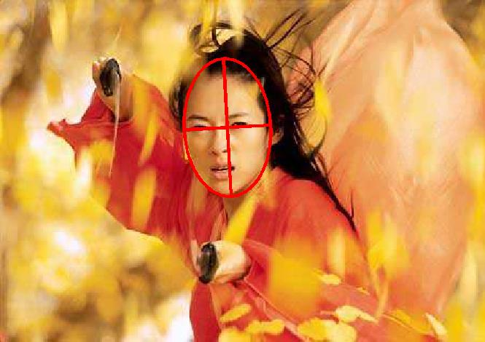
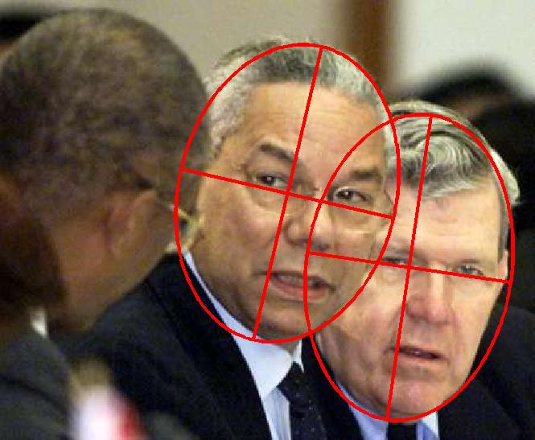
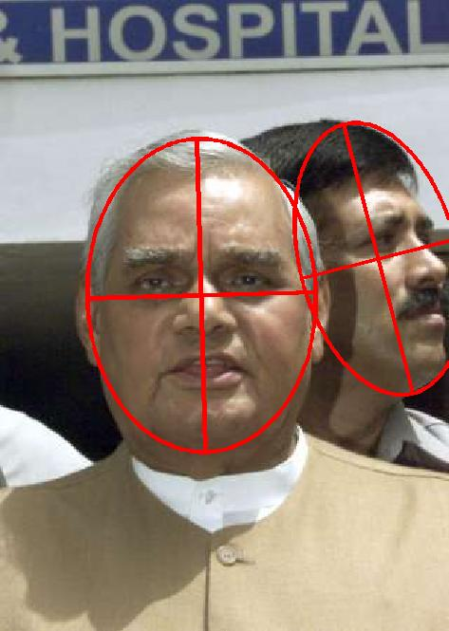
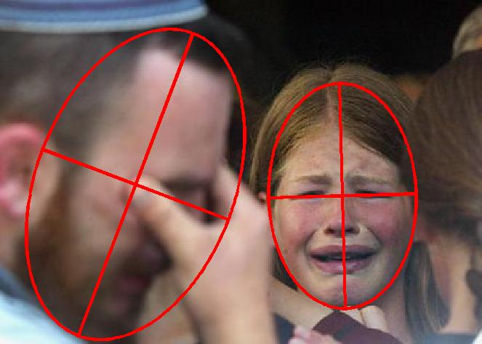
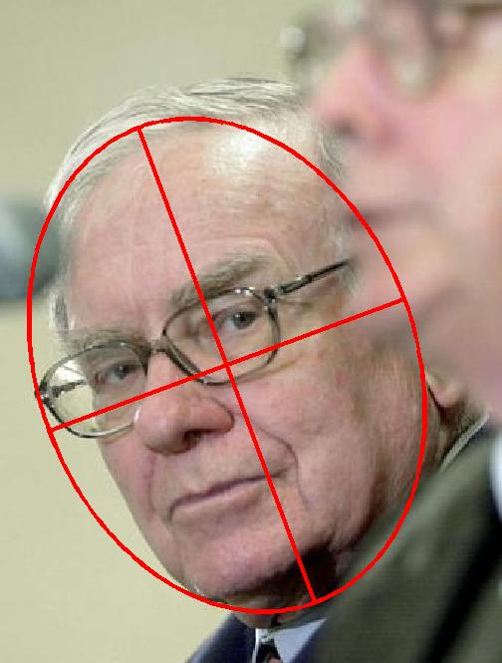
Face Detection - Evaluation
http://vis-www.cs.umass.edu/fddb/

Slide 57
Face Detection - Evaluation
TP = number of true positives
FP = number of false positives
FN = number of false negatives
TN = number of true negatives
precision = TP/(TP+FP)
sensitivity = TP/(TP+FN)
F1 score (harmonic mean of precision and sensitivity) = 2 ×
precision × sensitivity/(precision + sensitivity)

Slide 58
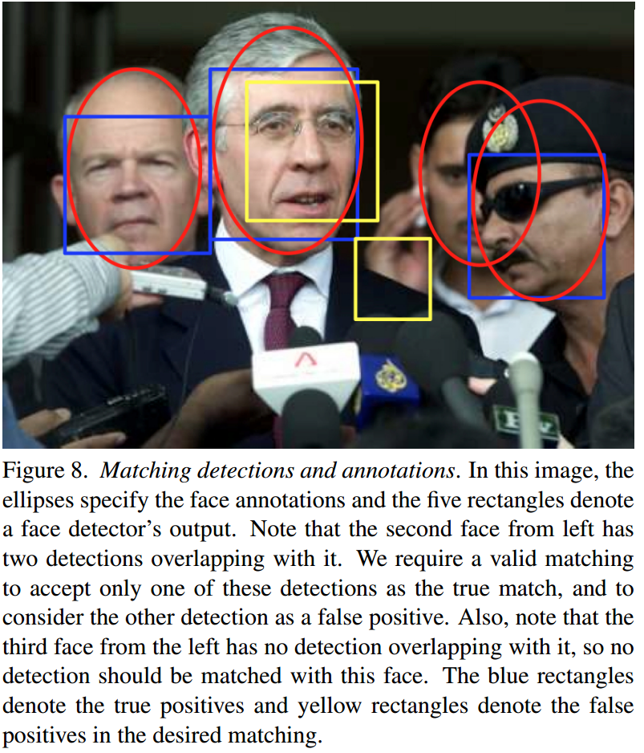
Face Detection - Evaluation
http://vis-www.cs.umass.edu/fddb/

Slide 59
Haar Features
Since Viola and Jones popularized the Haar-like features for face detection, the Haarlike features and their modifcations were used in many detection tasks (e.g. pedestrian, eye, vehicle).
In the area of pedestrian detection, in [1], the authors presented the component-based person detector that is able to detect the occluded people in clustered scenes in static images. The detector uses the Haar-like features to describe the components of people (heads, legs, arms) combined with the SVM classifer. The Viola and Jones detection framework was successfully extended for moving-human detection in [2]. In [3], the authors proposed the method for estimating the walking direction of pedestrian.

Slide 60
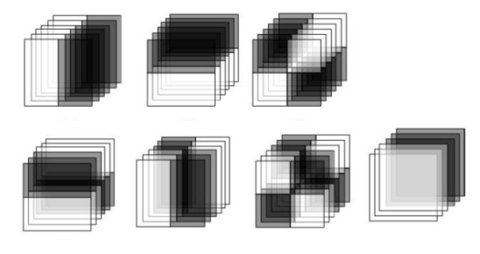
Haar Features
The 3D Haar-like features for pedestrian detection were presented
in [4]. The authors extend the classical Haar-like features using the volume flters in 3D space (instead of using rectangle flters in 2D space) to capture motion information. The 3D features are then combined with the SVM classifer. To compute the 3D Haar-like features using the integral image like the classical 2D features, the authors introduced Integral Volume that extends 2D integral image to the three dimensions.

Slide 61
Haar Features
[1] Mohan, A., Papageorgiou, C., Poggio, T.: Example-based object detection in images by components. IEEE Trans. Pattern Anal. Mach. Intell. 23(4), 349–361 (Apr 2001), http://dx.doi.org/10.1109/34.917571
[2] Viola, P., Jones, M., Snow, D.: Detecting pedestrians using patterns of motion and appearance. In: Computer Vision, 2003. Proceedings. Ninth IEEE International Conference on. pp. 734 –741 vol.2 (oct 2003)
[3] Shimizu, H., Poggio, T.: Direction estimation of pedestrian from multiple still images. In: Intelligent Vehicles Symposium, 2004 IEEE. pp. 596–600 (2004)
[4] Cui, X., Liu, Y., Shan, S., Chen, X., Gao, W.: 3d haar-like features for pedestrian detection. In: Multimedia and Expo, 2007 IEEE International Conference on. pp. 1263–1266 (July 2007)

Slide 62
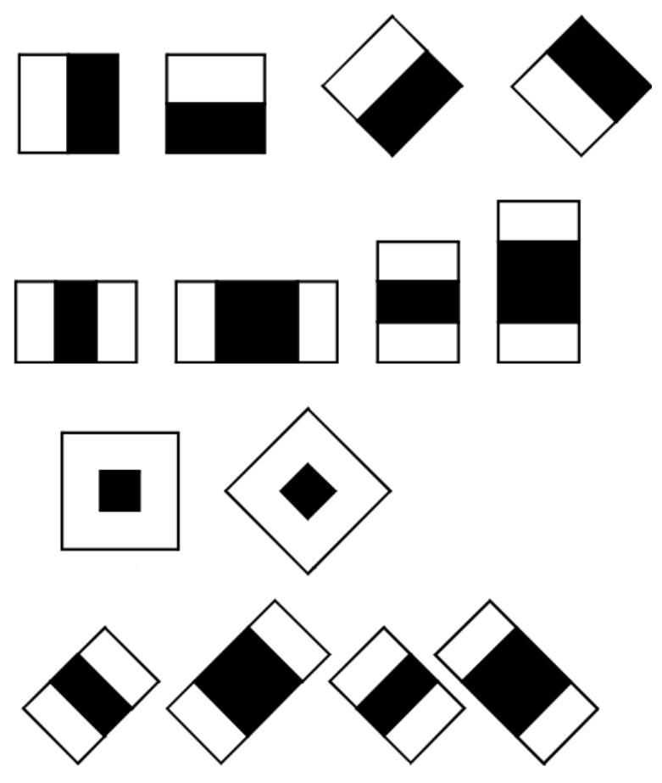
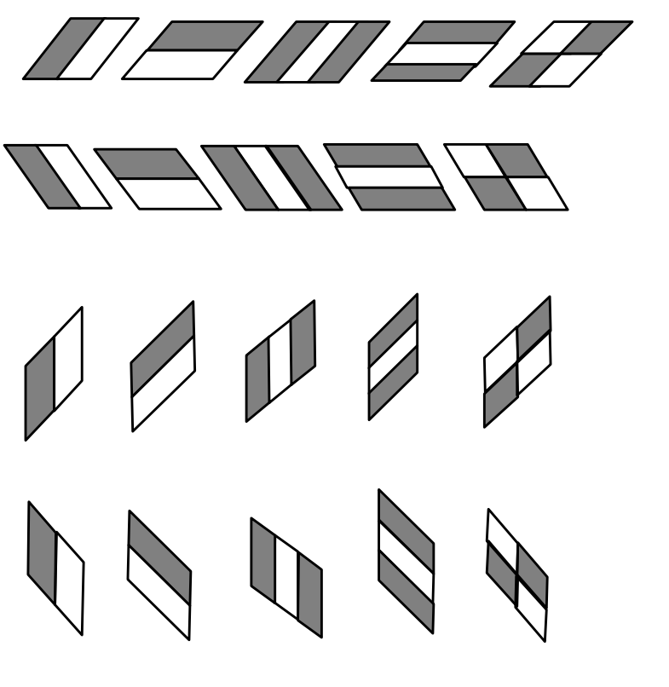
Haar Features
The modified version of Haar-like features that more properly reflect the shape of the pedestrians than the classical Haar-like features.
Lienhart, R., Maydt, J.: An extended set of haar-like features for rapid
object detection. In: Image Processing. 2002. Proceedings. 2002 International Conference on. vol. 1, pp. I–900–I–903 vol.1 (2002)
Hoang, V.D., Vavilin, A., Jo, K.H.: Pedestrian detection approach based on modified haar-like features and adaboost. In: Control, Automation and Systems (ICCAS), 2012 12th International Conference on. pp. 614-618 (Oct 2012)

Slide 63
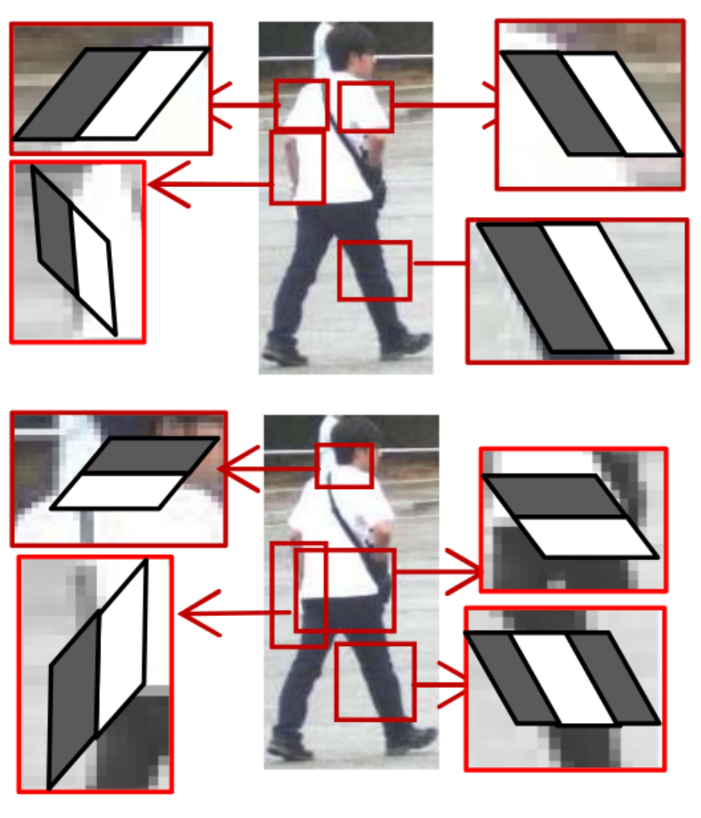
Haar Features
The modified version of Haar-like features that more properly reflect the shape of the pedestrians than the classical Haar-like features.
Hoang, V.D., Vavilin, A., Jo, K.H.: Pedestrian detection approach based on modified haar-like features and adaboost. In: Control, Automation and Systems (ICCAS), 2012 12th International Conference on. pp. 614-618 (Oct 2012)

Slide 64
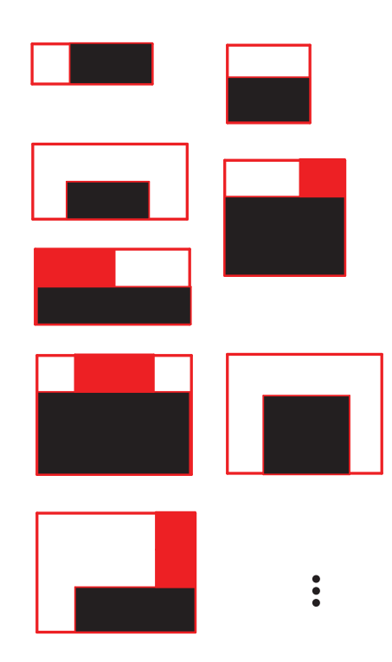

Haar Features
The modified version of Haar-like features that more properly reflect the shape of the pedestrians than the classical Haar-like features.
S. Zhang, C. Bauckhage, and A. B. Cremers. Informed haar-like features improve pedestrian detection. In CVPR, 2014.

Slide 65

Haar Features
The modified version of Haar-like features that more properly reflect the shape of the pedestrians than the classical Haar-like features.
Zheng, W., Liang, L.: Fast car detection using image strip features. In: Computer Vision and Pattern Recognition, 2009. CVPR 2009. IEEE Conference on. pp. 2703–2710 (2009)

Slide 66

Fusek, R., Mozdřeň, K., Šurkala, M., Sojka, E.: AdaBoost for Parking Lot Occupation Detection. Advances in Intelligent Systems and Computing, vol. 226, pp. 681-690 (2013)
http://mrl.cs.vsb.cz/
Parking Lot Occupation

Slide 67
Haar
HOG
LBP
SIFT, SURF KeyPoints
CNNs
Traditional Approaches
Deep Learning Approach

Slide 68
Related Works
2000
Papageorgiou
(2000)
Viola, Jones
(2001,2004)
Dalal, Triggs
(2005)
cit. 10947
2005

Slide 69

Pedestrian Detection - Challenges?

Slide 70
Histograms of Oriented Gradients (HOG)
In recent years, the object detectors that are based on edge analysis that provides valuable information about the objects of interest were used in many detection tasks. In this area, the histograms of oriented gradients (HOG) [1] are considered as the state-of-theart method.
In HOG, a sliding window is used for detection. The window is divided into small connected cells in the process of obtaining HOG descriptors. The histograms of gradient orientations are calculated in each cell. It is desirable to normalize the histograms across a large block of image. As a result, a vector of values is computed for each position of window. This vector is then used for recognition, e.g. by the Support Vector Machine classifier.

Slide 71

Histograms of Oriented Gradients (HOG)
Basic Steps:
In HOG, a sliding window is used for detection.
The window is divided into small connected cells.
The histograms of gradient orientations are calculated in each cell.
Support Vector Machine (SVM) classifier.
http://host.robots.ox.ac.uk/pascal/VOC/voc2006/slides/dalal.ppt

Slide 72



Histograms of Oriented Gradients (HOG)
For gradient computation, the image without Gaussian smoothing is filtered with the [1, 0, -1] kernel to compute the horizontal and vertical derivatives.
Then the derivatives are used to compute the magnitude of the gradient and orientation .

Slide 73
Histograms of Oriented Gradients (HOG)
In the next step, the image is divided into the cells and the cell histograms are constructed. The histogram bins are spread over 0 to 180 degrees or 0 to 360 degrees. The corresponding histogram bin is found for each pixel inside the cell. Each pixel contributes a weighted vote for its corresponding bin. The pixel contribution can be the gradient magnitude.
Next step represents contrast normalization. For this purpose, the cells are grouped into the large blocks (i.e. 2×2 cells are considered as blocks). The histograms are normalized within the blocks (e.g. using L2-norm). In the paper, the two main block geometries are presented; rectangular and circular.
The final HOG descriptor is represented by histogram vectors of all blocks within the detection window

Slide 74

Histograms of Oriented Gradients (HOG)
Dalal and Trigs experimented with the size of detection window and they suggested the rectangular window with the size 64 × 128 pixels.
They also tried to reduce the size of the window to 48 × 112 pixels. Nevertheless, they obtained the best detection result with the size 64 × 128 pixels.

Slide 75

Histograms of Oriented Gradients (HOG)
Blocks, Cells:
8 x 8 cell
16 x 16 block – overlap
normalization within the blocks
Final Vector: Collect HOG blocks into vector

Slide 76
Histograms of Oriented Gradients (HOG)
The classical HOG descriptors suffer from the large number of features, which causes that the training and detection phases can be time consuming. The sufficient amount of training data is also needed to find a separating hyperplane by the SVM classifier.
Sometimes, it is desirable to use the methods for the dimensionality reduction of feature vector. In addition the that, the classical HOG descriptors are not rotation invariant.
These shortcomings became the motivation for creating many variations of HOG-based detectors. Many methods and applications based on HOG were presented in recent years.

Slide 77
Histograms of Oriented Gradients (HOG)
In [1], the authors applied the principal component analysis (PCA) to the HOG feature vector to obtain the PCA-HOG vector. This vector contains the subset of HOG features and the vector is used as an input for the SVM classifier. Their method was used for pedestrian detection with the satisfactory results.
Felzenszwalb et al. proposed the part-based detector that is based on HOG. In this method, the objects are represented using the mixtures of deformable HOG part models and these models are trained using a discriminative method (see following image). This method obtained excellent performance for object detection tasks [2, 3].
[1] Kobayashi, T., Hidaka, A., Kurita, T.: Neural information processing. chap. Selection of Histograms of Oriented Gradients Features for Pedestrian Detection, pp. 598–607. Springer-Verlag, Berlin, Heidelberg (2008)
[2] Felzenszwalb, P.F., McAllester, D.A., Ramanan, D.: A discriminatively trained, multiscale, deformable part model. In: CVPR (2008)
[3] Felzenszwalb, P., Girshick, R., McAllester, D., Ramanan, D.: Object detection with discriminatively trained part-based models. Pattern Analysis and Machine Intelligence, IEEE Transactions on 32(9), 1627–1645 (2010)

Slide 78

Histograms of Oriented Gradients (HOG)
An example of person detection using a part model. The model is defined by the coarse global template that covers the entire object and higher resolution part templates. The templates represent the histogram of oriented gradient [2].
[1] Kobayashi, T., Hidaka, A., Kurita, T.: Neural information processing. chap. Selection of Histograms of Oriented Gradients Features for Pedestrian Detection, pp. 598–607. Springer-Verlag, Berlin, Heidelberg (2008)
[2] Felzenszwalb, P.F., McAllester, D.A., Ramanan, D.: A discriminatively trained, multiscale, deformable part model. In: CVPR (2008)
[3] Felzenszwalb, P., Girshick, R., McAllester, D., Ramanan, D.: Object detection with discriminatively trained part-based models. Pattern Analysis and Machine Intelligence, IEEE Transactions on 32(9), 1627–1645 (2010)

Slide 79

Practical Example – Detection + Recognition
Consider the following problem: Find and recognize two following lego kits

Slide 80

OpenCV - http://opencv.org/
http://opencv.org/

Slide 81




Detection step HOG+SVM (OpenCV)
https://docs.opencv.org/3.1.0/d1/d73/tutorial_introduction_to_svm.html

Slide 82

Alien

Slide 83

Avenger

Slide 84

Negative Set

Slide 85


Sliding Window (detectMultiScale)
https://github.com/opencv/opencv/blob/master/samples/cpp/train_HOG.cpp

Slide 86
Haar
HOG
LBP
SIFT, SURF KeyPoints
CNNs
Traditional Approaches
Deep Learning Approach

Slide 87






Related Works
2006
Ahonen at al.
(2006)
1300 cit. SCOPUS
Zhang at al.
(2007)
Xiaohua at al.
(2009)
2009

Slide 88
Were introduced by Ojala et al. for the texture analysis.
The local binary patterns (LBP) were introduced by Ojala et al. [2, 3] for the texture analysis. The main idea behind LBP is that the local image structures (micro patterns such as lines, edges, spots, and ﬂat areas) can be effciently encoded by comparing every pixel with its neighboring pixels. In the basic form, every pixel is compared with its neighbors in the 3 × 3 region. The result of comparison is the 8-bit binary number for each pixel; in the 8-bit binary number, the value 1 means that the value of center pixel is greater than the neighbor and vice versa. The histogram of these binary numbers (that are usually converted to decimal) is then used to encode the appearance of region.
LBP - Local Binary Patterns

Slide 89

LBP - Local Binary Patterns
The important properties of LBP are the resistance to the lighting changes
and a low computational complexity.
Duo to their properties, LBP were used in many detection tasks, especially in facial image analysis [1, 4].
https://docs.opencv.org/2.4/modules/contrib/doc/facerec/facerec_tutorial.html#local-binary-patterns-histograms

Slide 90
[1] Ahonen, T., Hadid, A., Pietikainen, M.: Face description with local binary patterns: Application to face recognition. Pattern Analysis and Machine Intelligence, IEEE Transactions on 28(12), 2037–2041 (2006)
[2] Ojala, T., Pietikainen, M., Harwood, D.: A comparative study of texture measures with classifcation based on featured distributions. Pattern Recognition 29(1), 51–59 (Jan 1996), http://dx.doi.org/10.1016/0031-3203(95)00067-4
[3] Ojala, T., Pietikainen, M., Maenpaa, T.: A generalized local binary pattern operator for multiresolution gray scale and rotation invariant texture classifcation. In: Proceedings of the Second International Conference on Advances in Pattern Recognition. pp. 397–406. ICAPR ’01, Springer-Verlag, London, UK, UK (2001),
http://dl.acm.org/citation.cfm?id=646260.685274
[4] Ahonen, T., Hadid, A., Pietikainen, M.: Face recognition with local binary patterns. In: Pajdla, T., Matas, J. (eds.) Computer Vision - ECCV 2004, Lecture Notes in Computer Science, vol. 3021, pp. 469–481. Springer Berlin Heidelberg (2004)
LBP - Local Binary Patterns

Slide 91

LBP - Local Binary Patterns
Robust to monotonic changes in illumination
https://docs.opencv.org/2.4/modules/contrib/doc/facerec/facerec_tutorial.html#local-binary-patterns-histograms

Slide 92

LBP - Local Binary Patterns
Ojala T, Pietikäinen M & Mäenpää T (2002) Multiresolution gray-scale and rotation invariant texture classification with Local Binary Patterns. IEEE Transactions on Pattern Analysis and Machine Intelligence 24(7):971-987

Slide 93

LBP - Local Binary Patterns
Ojala T, Pietikäinen M & Mäenpää T (2002) Multiresolution gray-scale and rotation invariant texture classification with Local Binary Patterns. IEEE Transactions on Pattern Analysis and Machine Intelligence 24(7):971-987

Slide 94

LBP - Local Binary Patterns

Slide 95

LBP - Local Binary Patterns
https://docs.opencv.org/2.4/modules/contrib/doc/facerec/facerec_tutorial.html#local-binary-patterns-histograms

Slide 96

LBP - Local Binary Patterns

Slide 97
LBP - Local Binary Patterns
In [1], LBP were used for solving the face detection problem in low-resolution images. In this approach, the 19 × 19 face images are divided into the 9 overlapping regions in which the LBP descriptors are computed. Additionally, the LBP descriptors are extracted from the whole 19 × 19 image. The descriptors are then used to create the feature vector, and the SVM classifer with a polynomial kernel is used for the fnal classifcation.
[1] Hadid, A., Pietikainen, M., Ahonen, T.: A discriminative feature space for detecting and recognizing faces. In: Computer Vision and Pattern Recognition, 2004. CVPR 2004. Proceedings of the 2004 IEEE Computer Society Conference on. vol. 2, pp. II–797–II–804 Vol.2 (2004)

Slide 98

LBP - Local Binary Patterns
[1] Hadid, A., Pietikainen, M., Ahonen, T.: A discriminative feature space for detecting and recognizing faces. In: Computer Vision and Pattern Recognition, 2004. CVPR 2004. Proceedings of the 2004 IEEE Computer Society Conference on. vol. 2, pp. II–797–II–804 Vol.2 (2004)

Slide 99
LBP - Local Binary Patterns
Multi-block local binary patterns (MB-LBP) for face detection and recognition were proposed in [1, 2]. In this method, the authors encode the rectangular regions by the local binary pattern operator and the Gentle AdaBoost is used for feature selection. Their results showed that MBLBP are more distinctive than the Haar-like features and the original LBP features.
[1] Zhang, L., Chu, R., Xiang, S., Liao, S., Li, S.Z.: Face detection based on multi-block lbp representation. In: Proceedings of the 2007 international conference on Advances in Biometrics. pp. 11–18. ICB’07, Springer-Verlag, Berlin, Heidelberg (2007)
[2] Liao, S., Zhu, X., Lei, Z., Zhang, L., Li, S.Z.: Learning multi-scale block local binary patterns for face recognition. In: ICB. pp. 828–837 (2007)

Slide 100

LBP - Local Binary Patterns
[1] Zhang, L., Chu, R., Xiang, S., Liao, S., Li, S.Z.: Face detection based on multi-block lbp representation. In: Proceedings of the 2007 international conference on Advances in Biometrics. pp. 11–18. ICB’07, Springer-Verlag, Berlin, Heidelberg (2007)
[2] Liao, S., Zhu, X., Lei, Z., Zhang, L., Li, S.Z.: Learning multi-scale block local binary patterns for face recognition. In: ICB. pp. 828–837 (2007)

Slide 101
LBP - Local Binary Patterns
The paper of Tan and Triggs [2] proposed the face recognition method with robust preprocessing based on the difference of Gaussian image filter combined with LBP in which the binary LBP code is replaced by the ternary code to create local ternary patterns (LTP).
LBP were also successfully used for the facial expression analysis. The coarse-tofine classification scheme with LBP combined with the k-nearest neighbor classifier that carries out the final classification was proposed in [1].
The comprehensive study of facial expression recognition using LBP was proposed in [78], the survey of facial image analysis using LBP was presented in [38].
[1] Tan, X., Triggs, B.: Enhanced local texture feature sets for face recognition under diffcult lighting conditions. Image Processing, IEEE Transactions on 19(6), 1635–1650 (2010)
[2] Feng, X., Hadid, A., Pietikainen, M.: A coarse-to-fne classifcation scheme for facial expression recognition. In: Campilho, A., Kamel, M. (eds.) Image Analysis and Recognition. Lecture Notes in Computer Science, vol. 3212, pp. 668–675. Springer Berlin Heidelberg (2004)
[3] Shan, C., Gong, S., McOwan, P.W.: Facial expression recognition based on local binary patterns: A comprehensive study. Image Vision Comput. 27(6), 803–816 (May 2009)
[4] Huang, D., Shan, C., Ardabilian, M., Wang, Y., Chen, L.: Local binary patterns and its application to facial image analysis: A survey. Systems, Man, and Cybernetics, Part C: Applications and Reviews, IEEE Transactions on 41(6), 765–781 (Nov 2011)

Slide 102
Haar
HOG
LBP
SIFT, SURF KeyPoints
CNNs
Traditional Approaches
Deep Learning Approach

Slide 103
KeyPoints
The most of the previously mentioned methods for object description were based on the fact that the descriptors were extracted over the whole image (sliding window) that was usually divided into the overlap or non-overlap regions. Inside these regions, the descriptors were calculated and combined to the final feature vector that was used as an input for the classifier.
In this lecture, we present the state-of-the-art descriptors that are based on the fact that the regions (within which the descriptors are extracted) are selected using the keypoint detectors.

Slide 104
KeyPoints - SIFT
One of the most popular descriptors based on the interest points was proposed by David Lowe [1, 2, 3]. The method is called scale invariant feature transform (SIFT).
The idea of the SIFT descriptor is that the interesting points (keypoints) of the objects can be extracted to provide the key information about the objects. The gradient magnitude and orientation are computed around the keypoint location; the histograms are then summarized over subregions (see following image). The keypoints are extracted from the reference image (that contains the object of interest) and also from the target image (that possibly contains the object of interest). The extracted keypoints are matched to find similarity between the images.

Slide 105
KeyPoints - SIFT
Keypoints are invariant in the terms of:
  Scale
  Orientation
  Position
  Illumination
  Partially Occlusion

Slide 106

KeyPoints - SIFT
An example of SIFT keypoint descriptor in which the gradient orientation
and gradient magnitude around each interest point are used [3].
[1] Brown, M., Lowe, D.: Invariant features from interest point groups. In: In British Machine Vision Conference. pp. 656–665 (2002)
[2] Lowe, D.: Object recognition from local scale-invariant features. In: Computer Vision, 1999. The Proceedings of the Seventh IEEE International Conference on. vol. 2, pp. 1150–1157 vol.2 (1999)
[3] Lowe, D.G.: Distinctive image features from scale-invariant keypoints. Int. J. Comput. Vision 60(2), 91–110 (Nov 2004), http://dx.doi.org/10.1023/B: VISI.0000029664.99615.94

Slide 107
KeyPoints - SURF
The speeded up robust feature (SURF) descriptor by Bay et al. [1, 2] is also one of the widely used keypoint descriptors. In this method, the Hessian matrix-based measure is used to find the points of interest. The sum of the Haar-wavelet responses within the neighborhood of interest point is calculated. The authors also use the fast calculation via the integral image thanks to which SURF is faster than SIFT.
[1] Bay, H., Tuytelaars, T., Gool, L.J.V.: Surf: Speeded up robust features. In: ECCV (1). pp. 404–417 (2006)
[2] Bay, H., Ess, A., Tuytelaars, T., Van Gool, L.: Speeded-up robust features (surf). Comput. Vis. Image Underst. 110(3), 346–359 (Jun 2008)

Slide 108
KeyPoints – BRIEF/ORB
A very fast method called binary robust independent elementary features (BRIEF) was proposed by Calonder et al. [1]. The authors reported that the method outperforms SURF in the term of speed, and the recognition rate in many cases. In BRIEF, a binary string that contains the results of intensity differences of pixels are used and the descriptor similarity is evaluated using the Hamming distance. In [2], the authors proposed another binary descriptor with rotation and noise invariant properties called oriented fast and rotated BRIEF (ORB).
[1] Calonder, M., Lepetit, V., Strecha, C., Fua, P.: Brief: binary robust independent elementary features. In: Proceedings of the 11th European conference on Computer vision: Part IV. pp. 778–792. ECCV’10, Springer-Verlag, Berlin, Heidelberg
(2010)
[2] Rublee, E., Rabaud, V., Konolige, K., Bradski, G.: Orb: An effcient alternative to sift or surf. In: Computer Vision (ICCV), 2011 IEEE International Conference on. pp. 2564–2571 (2011)

Slide 109
KeyPoints – BRISK
Leutenegger et al. [1] proposed binary robust invariant scalable keypoints (BRISK). The method provides both scale and rotation invariance. BRISK is a binary descriptor like BRIEF and ORB, it means that the binary string that represents a region around the keypoint is composed. In BRISK, a concentric circle pattern of points near to the keypoint is used (see following image). In this pattern, the blue circles represent the sampling locations and Gaussian blurring is computed to be less sensitive to noise; the radius of red circles denotes a standard deviation of blurring kernel. The standard deviation of the Gaussian kernel is increased with the increasing distance from the feature center to avoid aliasing effects. The final descriptor is determined by the comparison of sample points.

Slide 110

KeyPoints – BRISK
BRISK sampling pattern [1]
[1] Leutenegger, S., Chli, M., Siegwart, R.: Brisk: Binary robust invariant scalable keypoints. In: Computer Vision (ICCV), 2011 IEEE International Conference on. pp. 2548–2555 (2011)

Slide 111
KeyPoints – FREAK
In [1], the authors proposed the fast retina keypoint (FREAK) descriptor that also uses the binary strings. The method is biologically inspired by a human visual system; more exactly by the retina. In this paper, the authors proposed a retinal sampling pattern; The following image shows the topology of this pattern. The pattern is divided into the areas (foveal, fovea, parafoveal, and perifoveal) similar to the human retina. In this pattern, the pixels are overlapped and concentrated near to the center. The binary strings is computed by comparing the point pairs of image intensities within the pattern.
[1] Alahi, A., Ortiz, R., Vandergheynst, P.: FREAK: Fast Retina Keypoint. In: IEEE Conference on Computer Vision and Pattern Recognition. IEEE Conference on Computer Vision and Pattern Recognition, Ieee, New York (2012)

Slide 112

KeyPoints – FREAK
FREAK sampling pattern [1]
[1] Alahi, A., Ortiz, R., Vandergheynst, P.: FREAK: Fast Retina Keypoint. In: IEEE Conference on Computer Vision and Pattern Recognition. IEEE Conference on Computer Vision and Pattern Recognition, Ieee, New York (2012)

Slide 113


KeyPoints - Example
The goal is to find image KeyPoints that are invariant in the terms of scale, orientation, position, illumination, partially occlusion.
template

Slide 114

KeyPoints - Example
https://docs.opencv.org/3.1.0/d5/d6f/tutorial_feature_flann_matcher.html

Slide 115
Haar
HOG
LBP
SIFT, SURF KeyPoints
CNNs
Traditional Approaches
Deep Learning Approach

Slide 116

Recognition
Alien vs. Avenger
?
?

Slide 117

CNNs – Main Steps (LeNet)
Convolution
Non Linearity (ReLU)
Pooling or Sub Sampling
Classification (Fully Connected Layer)
Convolution
+ ReLU
Pooling
Convolution
+ ReLU
Input Image
Pooling
Fully Connected
https://www.clarifai.com/technology

Slide 118


1. Convolution
Mask/Filter
Input Image
+ ReLU
+ ReLU
https://ujjwalkarn.me/2016/08/11/intuitive-explanation-convnets/

Slide 119

1. Convolution
Mask/Filter
Multiply the image pixels by pixels of the filter, then sum the results
+ ReLU
+ ReLU
https://ujjwalkarn.me/2016/08/11/intuitive-explanation-convnets/

Slide 120


1. Convolution
+ ReLU
+ ReLU
http://dimitroff.bg/image-filtering-your-own-instagram/

Slide 121

1. Convolution
+ ReLU
+ ReLU
http://cs.nyu.edu/~fergus/tutorials/deep_learning_cvpr12/

Slide 122
1. Convolution
Before training, we have many filters/kernels
  Filter values are randomized
Depth of this conv. layer corresponds to the number of filters we use for the convolution operation
The filters are learned during the training
+ ReLU
+ ReLU
http://cs.nyu.edu/~fergus/tutorials/deep_learning_cvpr12/

Slide 123

2. Non Linearity (ReLU)
ReLU is used after every Convolution operation
The goal of this step is to replace all negative pixels by zero in the feature map
+ ReLU
+ ReLU
http://mlss.tuebingen.mpg.de/2015/slides/fergus/Fergus_1.pdf

Slide 124
3. Pooling
( Subsampling or downsampling )
The goal of this step is to reduce the dimensionality of each feature map but preserve important informations
Operations: e.g. Sum, Average, Max
+ ReLU
+ ReLU

Slide 125

3. Pooling
( Subsampling or downsampling )
Common way is a pooling layer with filters of size 2x2 applied with a stride of 2
+ ReLU
+ ReLU
http://cs231n.github.io/convolutional-networks/

Slide 126

3. Pooling
( Subsampling or downsampling )
Common way is a pooling layer with filters of size 2x2 applied with a stride of 2
+ ReLU
+ ReLU
http://mlss.tuebingen.mpg.de/2015/slides/fergus/Fergus_1.pdf

Slide 127

Conv. + ReLU + POOL
Convolution layers and Pooling layers can be repeated any number of times in a single ConvNet.
http://cs231n.github.io/convolutional-networks/

Slide 128
4. Classification
Multi Layer Perceptron
The number of filters, filter sizes, architecture of the network etc. are fixed and do not change during training process.
Only the values of the filter matrix and connection weights get updated.
+ ReLU
+ ReLU
http://cs231n.github.io/convolutional-networks/

Slide 129
CovNet Architectures
LeNet (1990s)
AlexNet (2012)
ZF NET (2013)
GoogLeNet (2014)
VGGNet (2014)
ResNets (2015)
DenseNet (2016)
https://ujjwalkarn.me/2016/08/11/intuitive-explanation-convnets/

Slide 130

Dlib
http://dlib.net

Slide 131

Recognition step CNNs (Dlib)
http://dlib.net/dnn_introduction_ex.cpp.html

Slide 132
Recognition step CNNs (Dlib)
Convolution
+ ReLU
Pooling
Convolution
+ ReLU
Input Image
Pooling
Fully Connected
http://dlib.net/dnn_introduction_ex.cpp.html

Slide 133
Recognition step CNNs (Dlib)
Input Image
Convolution
+ ReLU
Pooling
Convolution
+ ReLU
Input Image
Pooling
Fully Connected
http://dlib.net/dnn_introduction_ex.cpp.html

Slide 134
Recognition step CNNs (Dlib)
6 conv. filters
5x5 filter size
1x1 stride
+ReLU
Convolution
+ ReLU
Pooling
Convolution
+ ReLU
Input Image
Pooling
Fully Connected
http://dlib.net/dnn_introduction_ex.cpp.html

Slide 135
Recognition step CNNs (Dlib)
MAX POOLING
2x2 window
2x2 stride
Convolution
+ ReLU
Pooling
Convolution
+ ReLU
Input Image
Pooling
Fully Connected
http://dlib.net/dnn_introduction_ex.cpp.html

Slide 136
Recognition step CNNs (Dlib)
16 conv. filters
5x5 filter size
1x1 stride
+ReLU
Convolution
+ ReLU
Pooling
Convolution
+ ReLU
Input Image
Pooling
Fully Connected
http://dlib.net/dnn_introduction_ex.cpp.html

Slide 137
Recognition step CNNs (Dlib)
MAX POOLING
2x2 window
2x2 stride
Convolution
+ ReLU
Pooling
Convolution
+ ReLU
Input Image
Pooling
Fully Connected
http://dlib.net/dnn_introduction_ex.cpp.html

Slide 138
Recognition step CNNs (Dlib)
Fully connected layer
120 neurons
84 neurons
10 outputs/classes
multiclass classification
Convolution
+ ReLU
Pooling
Convolution
+ ReLU
Input Image
Pooling
Fully Connected
http://dlib.net/dnn_introduction_ex.cpp.html

Slide 139

Recognition step CNNs (Dlib)
http://dlib.net/dnn_introduction_ex.cpp.html

Slide 140

Recognition step CNNs (Dlib)
http://dlib.net/dnn_introduction_ex.cpp.html

Slide 141
Exercise
DETECTING FREE/OCCUPIED PLACES IN PARKING LOTS
Motivation:
The vehicle detection systems using images have been very useful in the recent years. Especially nowadays in the cities, the increasing number of vehicles brings a major problem. The car detection systems can be important, especially for drivers who are looking for vacant spaces in the parking lots, for traffic analysis, for intelligent scheduling, for smart cities and so on.
Input Data:
The training data with a basic template (C++/OpenCV) can be found in the following link:
http://mrl.cs.vsb.cz/data/parking.zip

Slide 142
Exercise
description of template:
training and testing data are in the “testImages” and “trainImages” folders
each image is named as free_xx.png or full_xx.png (the name of the images represents the state of parking space)
functions for loading training/testing images are already implemented - train_parking(), test_parking()
the training and prediction steps are missing - You can use any available libraries to solve this detection task. The use of the provided main.cpp template is not required.

Slide 143

Exercise
Output:
If you successfully run the template, you obtain this output. It means that the accuracy of the detector is aprox. 32%. The accuracy is low because each parking space is labeled as occupied - line 82 in main.cpp. The goal is to implement better prediction approach.

Slide 144
Exercise
Hints:
Since we want to label each parking space as free (0) or occupied (1), this recognition problem can be solved using classical binary classifiers (SVM, neural networks). To train the classifiers, you can use the provided training data in the “trainImages” folder. As the input for the classifiers, you can use the whole image or you can use feature extraction approaches (e.g. histograms of oriented gradients, local binary patterns).
Alternatively, you can skip the training process and use simple color or gradient information for example. In that case, you can use only the test_parking() function without the training.
The provided template is based on the OpenCV library https://opencv.org/
Installation in Linux: https://www.learnopencv.com/install-opencv3-on-ubuntu/
Installation in Windows: https://www.learnopencv.com/install-opencv3-on-windows/
Installation in MacOS: https://www.learnopencv.com/install-opencv3-on-macos/
Simple install for Windows without cmake using NuGet:
  http://funvision.blogspot.com/2017/04/simple-install-opencv-visual-studio.html
  https://www.nuget.org/packages/opencv.win.native/320.1.1-vs141

Slide 145
Exercise
Hints:
Alternatively, you can install OpenCV from the Ubuntu or Debian repository:
  sudo apt-get install libopencv-dev python3-opencv
You can find the several tutorials in the following link: https://docs.opencv.org/3.4.2/d9/df8/tutorial_root.html
Dlib library represents another option how to solve this detection problem
  Installation in Windows https://www.learnopencv.com/install-dlib-on-windows/
  Installation in Linux https://www.learnopencv.com/install-dlib-on-ubuntu/
  Installation in MacOS: https://www.learnopencv.com/install-dlib-on-macos/
  You can follow this tutorial: http://dlib.net/dnn_introduction_ex.cpp.html
You can also use Keras, Caffe, TensorFlow, etc.

